Slide 1

Moving Quickly in a Disrupted World
Challenging yesterday’s sales and marketing paradigm in today’s uncertain environment to accelerate revenue

Slide 2




How we create impact
Brand
Ignite- Revenue Strategy Plan
Connect Sales Methodology
Science & Strategy
Vision
Leading &
Coaching Programs
Revenue
Revenue Transformation Roadmap
Management
Sales
Process & Customer Engage- ment
Vision
Revenue Results
Revenue Growth
Marketing
Art & Talent Optimization
Marketing Methodology- Customer Journey Mapping
Talent Accelerator- Competency Development
Brand
Notes:
Thank you Jo-Ann. We focus on Profitable Revenue Growth , like Maxine said we do that through elevating the level of play within sales, revenue management and marketing.
When people hear revenue growth, they automatically think revenue management, but it is the integration of those three critical disciplines that optimizes revenue.
The blue directional ring, shows how we help teams to create the right Science & Strategy, elevate how they engage with customers optimize and develop talent and lastly measure performance. We have done this for large organizations to small boutique hotels. The methodology and thinking is right; we just adjust the dosage
On the left are the programs that we have within our suite of products and the the right is some of our services

Slide 3









Performance Path
How we do it
4 | Revenue Performance & Metrics
How we measure real performance
1 | Science & Strategy
Who we hunt.
Who is the most profitable to hunt?
Asset: MPC Accelerator (Most Profitable Customer)
Performance that focuses on results vs. activity
2 | Process & Customer Engagement
How we hunt in Marketing, Sales & Revenue Management
Installing new approach & thinking that is relevant
3 | Art & Talent Optimization
How to develop your team to being masters in their job.
Asset: Talent Accelerator
Create long-term impact; see rapid results

Slide 4








Performance Path
Why it works
Having a strategic and disciplined path that equips the ability to pivot within marketplace shifts:
Focus:
Accountability on the right foundation
Repeatable Results.
Framework:
Build the tools and Resources to help teams to a sustain a new way of thinking
The uncommon becomes habit.
Foundation:
Build the new way to work so they know exactly what to do and when.

Slide 5
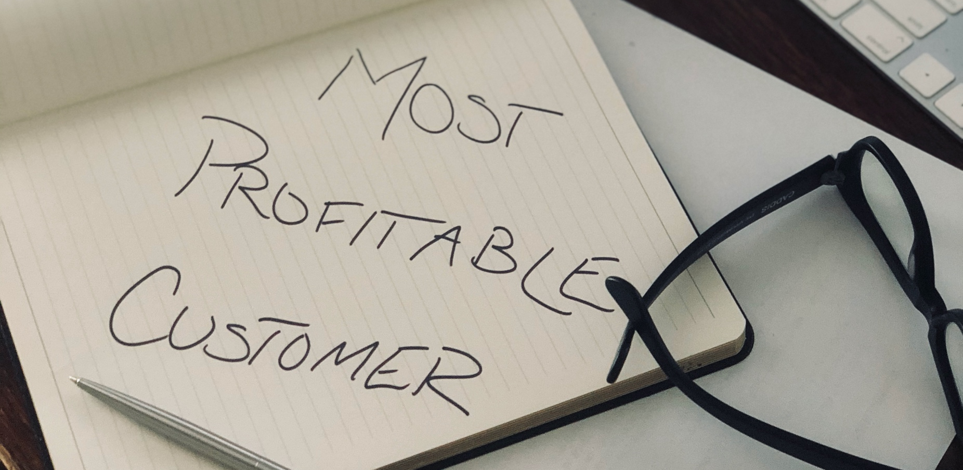
Notes:
Teams must understand what segments have the ability to grow. Meta-Segmants; Group, Transient and Crew relevant only to reporting….not to revenue strategy. Understanding customers and guests at the segment level i.e. Group - Corporate, AAA break strategy down to the segment level to be actionable and create results. A focus on meta-segment strategy is too ambiguous to create results. If you ask for ambiguity you get ambiguity. If you ask how they are going to grow group, be prepared for the politician's answer.
Within our MPC Acclerator, we can quickly see what segments and even what customers have the ability to grow in occupancy, rate or a blend of both and develop a plan from there.

Slide 6
“Life is a tale told by idiots, full of sound and fury, that signify nothing”
-Shakespeare’s Macbeth
Notes:
Shakespeare’s quote really resonates with me during many an asset management call. There is a long list of what the team is doing. What I call random acts of activity.
On our call when we get asked what we are doing. I have a long list of things we are doing”.
In 1981 the construct of SMART goals were introduced. And boy did they took hold. Today they are still widely used. They worked well when markets were growing and it wasn't as competitive.
They are activity based and a measurement of efficiencies vs. effectiveness.
40 Years later we have to be effective and efficent. More over we have create impact to our work.
Old thinking- look what we are doing
New thinking- did what we do, move the needle.

Slide 7

Alignment
Notes:
Best of class teams have the financial goal, strategy synopsis of how it is to be achieved, and tactics supporting the strategy.
Rarely do we see a roadmap that has the financial goal and a strategy of how to get there that is aligned with where they are going. In many cases there is no strategy. In one case a segment that was forecasted for the quarter to 20% of their revenue had a strategy of "We will not be offering Last Room Availablitly.
Financial Goals is the financial expectation, it is not the strategy.
Here is what one great strategy sounded likefor a team focused on corporate business. "to hit our financial goals we are looking 5000 additional rooms at a rate of $257. The four accounts that have that potential are: GE Healthcare- potential of 2000 roomnights, Kaiser Permenente Healthcare (1500 rooms) Kodak (500 roomnights, which is related to the hospital reimaging center). 500 roomnights from Medtronic. Below is our account development plan for each.

Slide 8
Notes:
I have protected the innocent- This is an example he financial goal, the strategy, and the tactics.
Strategy: They are looking to partner with third-party intermediaries, which drives up the cost of acquisition in the highest revenue segment for this hotel. There is no look at what accounts and how they look to grow revenue by 40%
Tactics: The tactics in green illustrate the time and effort that is being put towards the brand where they are selling to the brand vs. the customer
The tactics in pink illustrate the sales time and energy that were being allocated to the CVB Chamber or other random activities
The outline in blue represents the one tactic that mentions a corporate account.
Yet…. They were very busy. Their pipeline was over $2 million dollars, yet if we peeled away business that was not even awarded to the city or that they were working with directly that pipeline fell to $90k Which would not be make the financial projections for the quarter.

Slide 9

We take all the noise, disruption, frustration and complexity of the new economy and bring you a clear, concise and simple path for your team to get results.
Bringing Simplicity to Complexity

Slide 10
Emerging vs. Established Demand
Sales
Marketing
Rev. Mgmt
Revenue Growth
Creates demand or identifies Emerging Demand
Manages Established Demand
Notes:
So for today we are discussing sales and marketing. And leaving out revenue management. I love the three equally... but it is sales and marketing that need to be the work horses in this environment
Why? Because Revenue management manages existing demand. HIT Sales and Marketing create demand.
last year and through 2021 we are in a situation where we must create demand. To do so... sales and marketing have to reinvent themselves in order to be successful in this pursuit of demand creation

Slide 11

In businesses that are changing so fast, in a world ripe with disruption, and the unknowns outweigh the known, if you maintain the status quo you are likely going to experience failure. Status quo is a loosing strategy.
- Bob Iger, CEO Disney
Notes:
This quote Bob Igor and speaks directly to what we will exploring today. Steve Jobs had the same aversion to the status quo, from that aversion was borne Apple’s wildly successful mantra of ‘Think Different’ that brought Apple back from the verge of extinction.

Slide 12
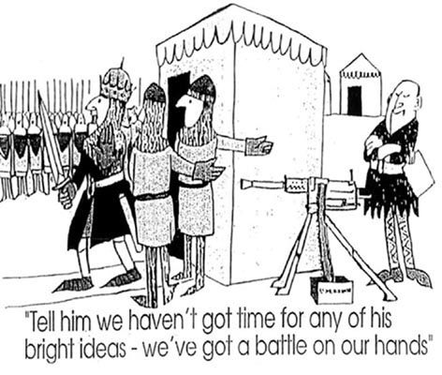
What worked in the past…Worked in the Past
Notes:
Net net….what we did Pre-Covid barely worked …. The nostalgia of how did it before, like Bob Igor said, is a loosing strategy. The key factor in moving away from what we did before to a new approach is mindset.

Slide 13
Shifting the Mindset Retreat and Reinvent
Ineffective mindset of today
Effective mindset for the future
Activity Focus
“this is what we are doing”
Strategy Focus
“Is the strategy moving the needle”
Product – price driven sale
Impact approach
“how do we help customers to create impact”
How we sell
(Product, Price, Promotions)
How customers buy
(Customer-Buying Journey)
Experience
Mindset
Notes:
Our clients have shared with us the t mindsets work in transformation Here are a few that relate to s &M HIT
Move away from an activity focus to strategy achievement HIT
Conversations beyond box. and understanding the hunters vs. gatherer environment
There are other key elements that we won't have time to hit on today, but can speak further about it at another time.

Slide 14

a step-wise approach
1
Retreat
2
Reinvent
3
Return
Strategy is Everything-
Kate Burda & Co
Strategic Leadership in Turbulent Times-
JH Hospitality
Hunters vs. Gathers = Demand Creation-
Kate Burda & Co
Mind Shift: Shaking the Tree-
JH Hospitality
Notes:
In the last few months we have listened to many calls, webinars, articles and teams
What was being presented was interesting and in fact was cause for alarm. What we saw was presenters and audiences were focused on when the market would return. All said it was unprecedented, referred to the new normal and what activities they should be doing that a repurposing of 'back to the basics"
No-one spoke of how do we show up differently in this dramatically new environment.
Here is what was missing:
What is the right strategy, or IS there a strategy?
Do we have the right competencies within the team and leaders in the future state.
Do we have the right mind set within our culture to actually do things differently.
Do we even have the right approach to customers that is beyond 'our stuff'
What we saw was sales and marketing teams and leaders seemingly waiting for the tide to rise, vs. reinventing for the future.
Albeit unprecedent, other events have proven that the revenue trifecta (sales, marketing, and revenue management” ) was indeed unsuccessful post 9/11 or the financial crisis. Within sales we had incredible growth within third paries, be it OTAs or other intermediaries, thusly a heartbreaking rise in cost of acquisition. Within Revenue management we saw rate decreases across the board to create demand.
The marketplace will be very different than it was before. Yet leaders may not know how to reinvent themselves to be successful;. History has shown that we haven’t learned lessons from the past and teams are waiting to return to do doing the same things they had done.
So in this post-apolcalyptic Covid environment, why are we hoping there will be anything different?
So here’s the good part. We have been studying and developing a road map to make a plan that works: Retreat, Reinvent, Return
Retreat: Building the Right Strategy, Structure, and leadership
Reinvent: Demand Creation – Hunter vs. Gatherer conversation and how critical it it is. And the abillity to be confident in the mindshift needed, shake the tree and put to bed nostalgic processes
We are going to give you a wine sampler of some of the key points Assets Managers will want to have marinating in your brain to be apart of the Return Roadmap.

Slide 15
Strategy isn’t something, it is everything
Most Profitable Customer
What are segments or customers that our your most profitable
Having a Strategy
What is the strategy ALIGNED to the financial goal.
Strategy is not tactics and it is not a financial goal.
Impact focus
Do less make it mean more
Notes:
Lets some foundation to what good strategy looks like in Revenue Acceleration
1- Having strategy that is focused on the most profitable segments and the ones that have an ability to grow
2- Having a strategy that ALIGNS to the financial goal.
3- Impact vs. Activity

Slide 16


Move From:
Activity based Focus
Notes:
So… Let go of operational mindset / construct of production and start demanding strategy focus

Slide 17

Notes:
Random acts of activity, what we have lovingly termed ‘Ducks and Bunnies”. Will not be successful in the new world. During this retreat is the PERFECT time to take the time to rebuild a strategy that is effective. If they are doing it now, they won’t be doing it in the future.

Slide 18
a step-wise approach
1
Retreat
2
Reinvent
3
Return
Strategy is Everything-
Kate Burda & Co
Demand Creation-
Kate Burda & Co

Slide 19

Reinvent- Hunters vs. Gathers
Notes:
This is such a great topic. So my goal is to give you some understanding of the why the hunter is so elusive.
If you remember the role of sales and marketing is to create demand.
Is it nurture or nature?

Slide 20

Elevating the revenue approach
How we engage with customers today was designed in 1970
Notes:
1- The sales and marketing approach that is being used and still taught by brands today was designed in 1970 by Wilson learning. The Needs Benefits Feature / NBF sales approach worked then and well I might add. Marriott invested heavily in it and it has been embedded in our world today.
Teams are using still using it...
Wilson Learning had abandoned it a decade ago..

Slide 21

Yet, we expect the performance meant for today
Teams need a relevant approach that is ‘beyond the room’
Revenue Leaders must have the same skills to deliver and coach
“you can’t give away what you don’t have”
Notes:
Although known very well. It does not work in todays world.
We have two issues; 1- there isn’t another methodology that is being considered, so either teams do the outdated approach or they don’t have an approach are professional visitors
2- sales leadership doesn’t have a different methodology or a proven way of doing anything different, thusly we have have a sales and marketing approach circa 1970. Even harder is they don’t know how to coach anything different. Because you can’t give away what you don’t have
How does this relate to hunter gatherer? Liken it to our teams hunting with a bow and arrow.

Slide 22
How Sales and Marketing creates demand
Recognition of impact
Resolution of Concerns
Purchase
Evaluation of Options
Consultative
Transactional
TIME
Having conversations at the recognition of impact or inspiration
Rather than the purchase phase
Source: Huthwaite
Notes:
Let me ask you give me your general definition of proactive selling?
Answer will probably be…when we reach out to the customer…
Lets explore that thinking together.
Whenever something happens there is a response. Apple loosing stock price, Shannon and Dane getting married, Price per barrel of oil. Whatever happens there is an organizational response. So lets take apple as an example. Their stock price decreases due to changes in tariff structures.
1- First there is a recognition of need- ”We have to do something” Lets get everyone together and look at the direction.
2- Then there is the evaluation of options. “Given what is in front of us what are our choices?” We evaluate plans of action
3- From there we have a resolution of concerns. ”This is our choice, this is the direction”
4- lastly is we decide to purchase. We involve those groups who are involved with the purchase portion.
What are some of the positions that you believe are related to the purchase?
When is our sales team showing up.... at the point of purchase.. when it is a product - price driven sale. When it shows up as a lead from a lead source... in a engagement we did 120 sales teammembers.
This customer buying journey helps to clarify what the difference is between the transactional sale and the consultative sale. When we engage with the customer at the recognition of need or the evaluation of options we are able to conduct a consultative partnership. When we engage at the point purchase we are transactional. Very difficult if not impossible in that space.
Here is the other difficulty that sales people have when we are in the selling in the purchase phase. More and more third-party companies are in this space, driving down the price and making it more commoditized and more of a price driven sale. Where they can’t compete is at the consultative level. If you are competing against third- party channels you are in a transactional sale.
We are know that we are times that we sell transactional or even have to sell transactionally. Our goal here is that we know how to prospect and sell with an approach that is about co-creation and partnership. We want and need you to have skills to sell both

Slide 23

Resource Allocation in a Time of Financial Prudence

Slide 24
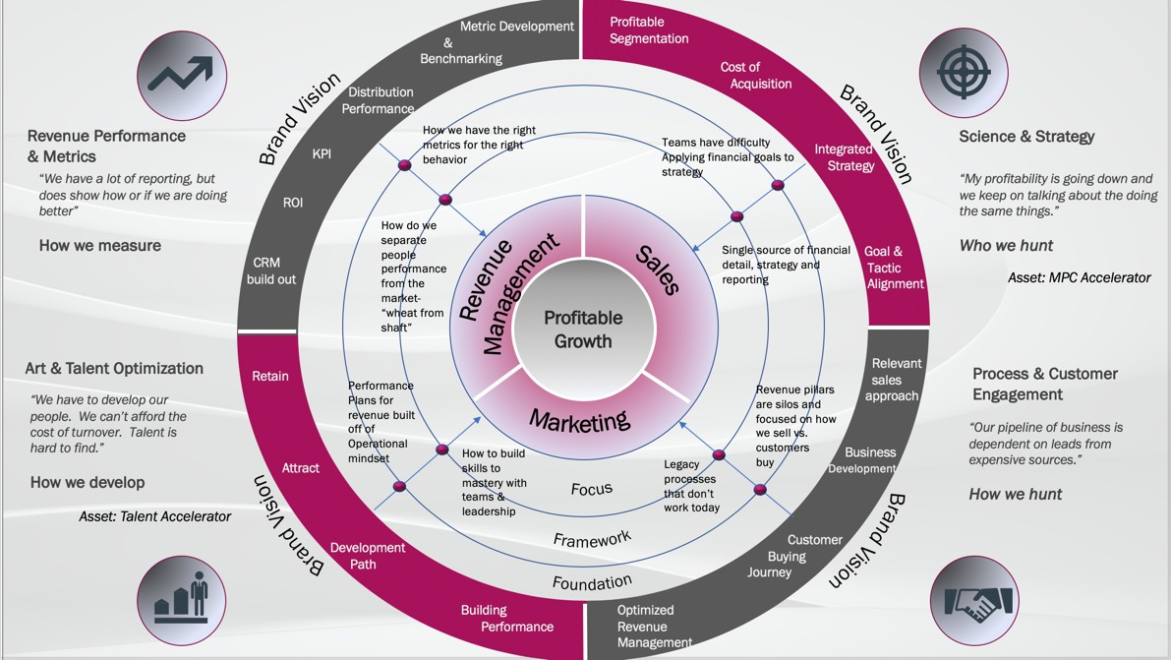
Where you win
6

Slide 25

Thank you
Kate Burda
Kate@kateburda.com
972.567.7792

